Slide 1
Setting up AWS account
Mr. Tamal Dey
Dept. of MCA,PESU

Slide 2
What is AWS
It is global cloud platform which allows to host applications and services on the internet.
Used by around 80% of fortune 500 companies to host the infrastructure
They provide the IaaS, PaaS (java,php,ruby), SaaS (email)
Hosting provider

Slide 3
Why it is such a hit?
The billing - Per hour billing, Micro billing
Easy signup process
Simple billing dashboard
Services are stable
Trusted vendor

Slide 4
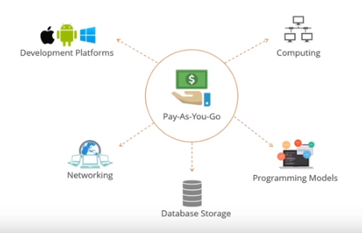
Why AWS?

Slide 5
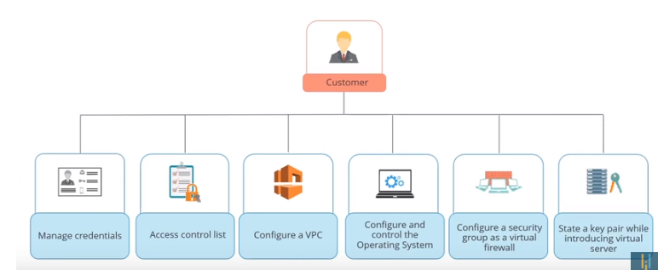

Slide 6
Service overview
EC2 – bare service, a machine can be launched
VPC- virtual private cloud
S3- simple storage service – upload and share files
RDS- run and manage databases on the cloud – Mysql, Oracle, Postgresql
Route 53 – DNS service
Auto scaling – capacity to scale on the fly
ELB- Elastic load balancing – scale up in multiple traffic

Slide 7
How much it costs
Per hour billing for almost everything
Region specific pricing –Virginia-cheapest
Term specific pricing – year pricing is cheap (has discounts)
Spot resources

Slide 8
How big is it?
18 regions
Global footprint – 1 million active customers in 190 countries, and steadily increasing
Massive data centres (3000 – 5000)
Multiple availability zones per region
Notes:
https://www.zdnet.com/article/aws-with-more-than-1-million-active-customers-were-your-stack/
https://www.sify.com/finance/indian-enterprises-going-whole-hog-on-cloud-adoption-aws-news-finance-tfopE1acjchce.html

Slide 9
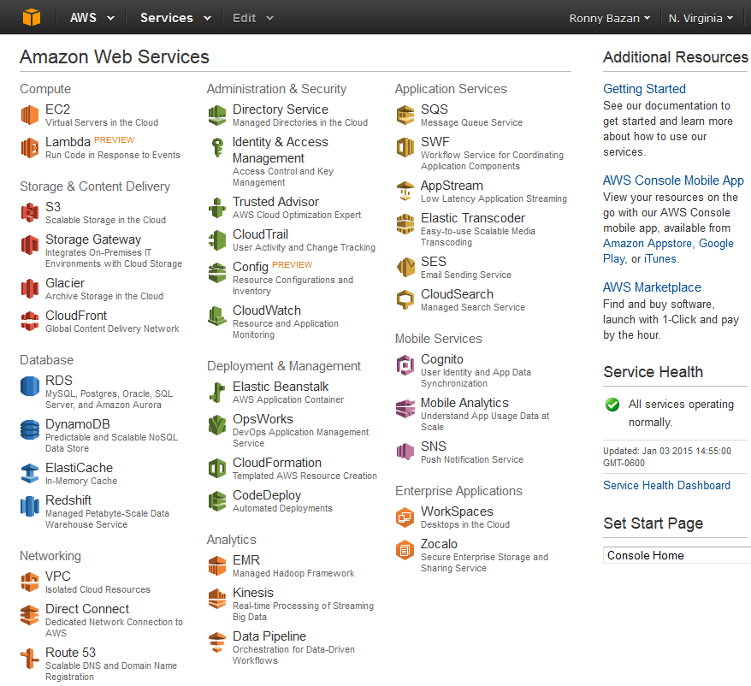
AWS Free-Tier

Slide 10
Advantages
64 services currently
Launching new services in all domains
Focus on machine learning
Focus on SAAS products
Reduction in costs

Slide 11
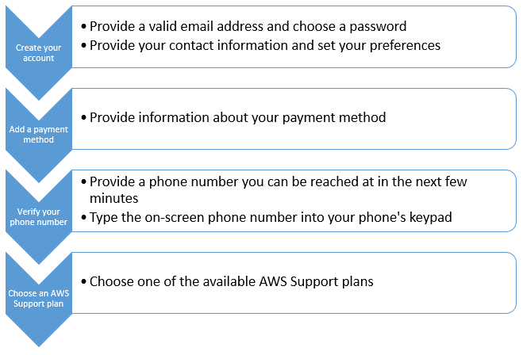
Setting up AWS account

Slide 12
Go to the Amazon Web Services home page.
Choose Sign Up. Note: If you've signed in to AWS recently, it might say Sign In to the Console.
Type the requested account information, and then choose Continue. Note: If Create a new AWS account isn't visible, first choose Sign in to a different account, and then choose Create a new AWS account. When creating a new account, be sure that you enter your account information correctly, especially your email address. If you enter your email address incorrectly, you might not be able to access your account or change your password in the future.
Choose Personal or Professional. Note: These two account types are identical in functionality.
Type the requested company or personal information.
Read the AWS Customer Agreement, and then check the box.
Choose Create Account and Continue.
Note: After you receive an email to confirm that your account is created, you can sign in to your new account using the email address and password you supplied. However, you must continue with the activation process before you can use AWS services.

